Slide 1




PAGE 1
What Is a Feature and
?its role in Making a model
made by
mona mohammed
mariem emad

Slide 2

PAGE 2
What is a Feature?
A feature is a measurable characteristic of data
its provides useful information forunderstanding data

Slide 3
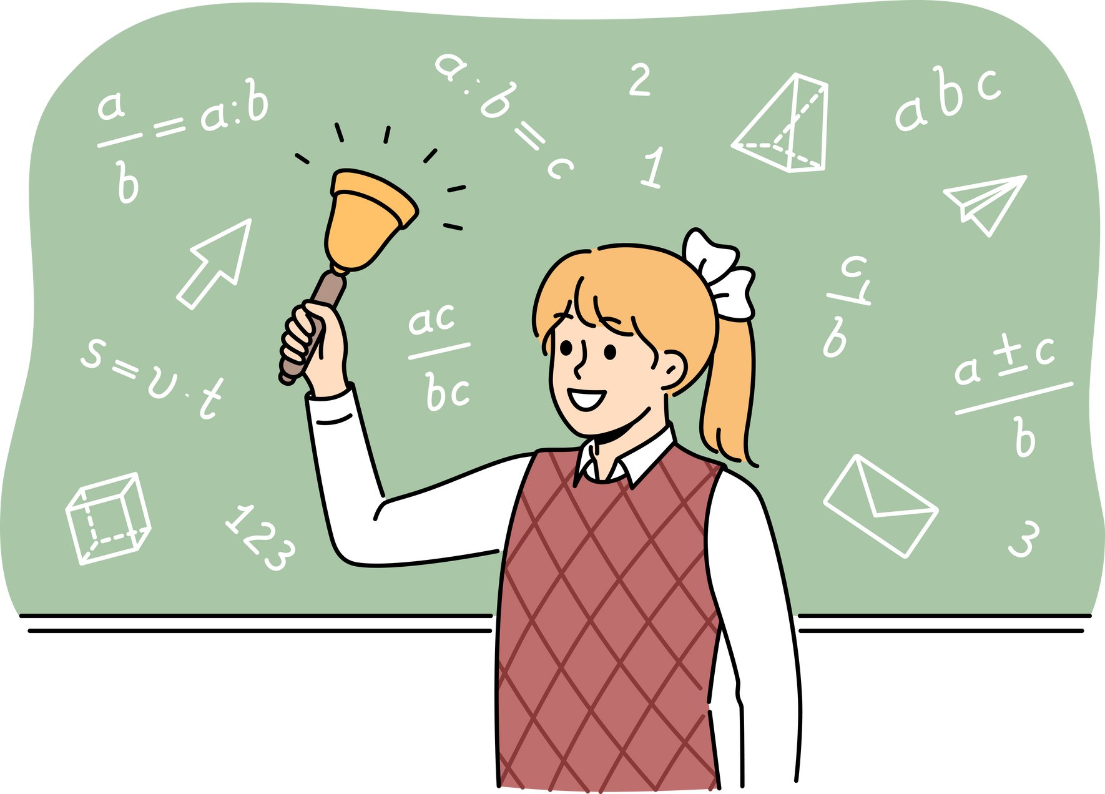
PAGE 3
Example
FACE RECOGNITION
SPEECH RECOGNITION
EMAIL SPAM
Distance between eyes
pitch
keywords in email
face shape
volume
number of links
frequency
sender address
Nose width
skin texture
speech speed
email length

Slide 4

PAGE 4
RULE OF FEATURES
Provide information to the model
Improve learning and accuracy
Directly affect model performance

Slide 5



PAGE 5
THE IMPACT OF FEATURE
QUALITY
FASTER TRAINING TIMES
SLOWER TRAINING AND COVERGENCE
IMPROVED MODEL ACCURACY
DECREASED PREDICTION ACCURANCY
BETTER INTERPRETABILITY OF RESULTS
REDUCED RISK OF OVERFITING
INCREASED POTENTIAL FOR BAIS

Slide 6

PAGE 6
?WHAT IS A MODEL
A MODEL LEARNS FROM FEATURES
TO MAKE PREDICTIONS OR DECISIONS.

Slide 7

PAGE 7
WHY DO WE USE MODEL?
TO MAKE COMPLEX SYSTEM EASIER
TO REDUCE ERRORS
TO PREDUIT RESULTS BEFORE REAL IMMPLEMENTATION

Slide 8

PAGE 8
CHARACTERISTICS OF GOOD MODEL
SIMPLE AND EASY TO UNDERSTAND
CAN BE UPDATED OR IMPROVED
REPRESENTS REALITY ACCURATELY

Slide 9

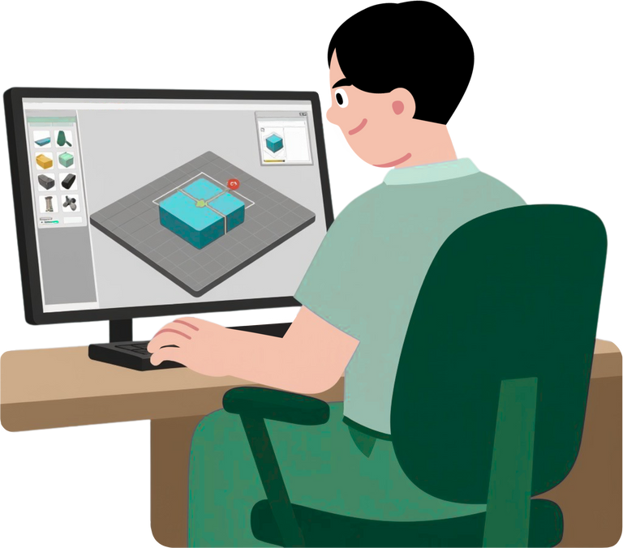

PAGE 9
TYPES OF MODELS
PHYSICAL
COMPUTER MODEL
MATHEMATICAL MODEL

Slide 10

PAGE 10
CONCLUTION
FEATURES ARE THE FOUNDATION OF
ANY MODEL.
Better features lead to better results.

Slide 11

PAGE 11
THANKS!

